Slide 1
Study group 9

Slide 2
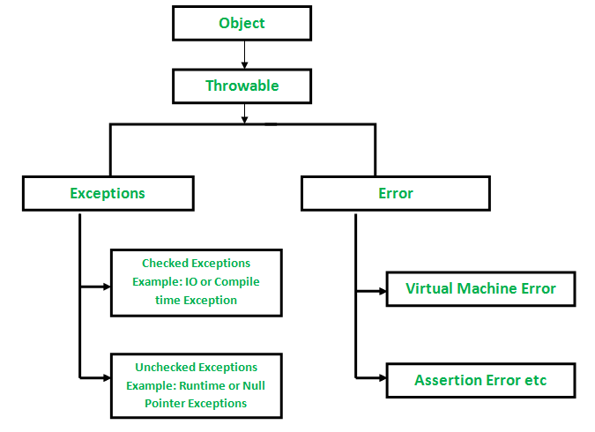
Exceptions

Slide 3
Compile Time | RunTime
Must be caught or declared | Runs unchecked until thrown during execution
Can’t compile until resolve | Compiles

Slide 4
List
Methods:
add
Remove
IsEmpty
Size

Slide 5
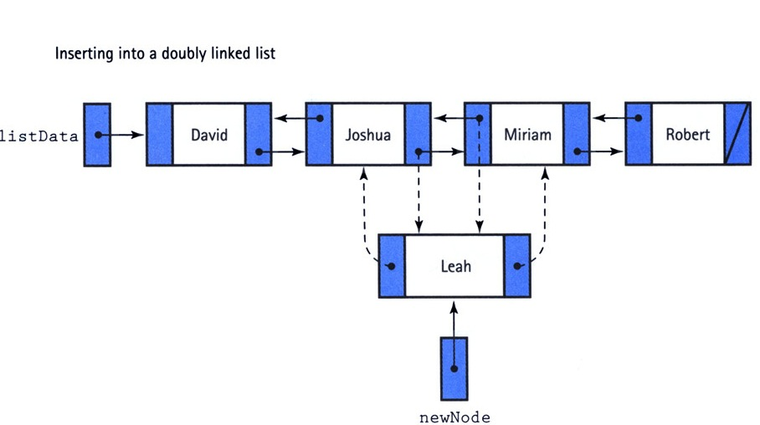
Linked list: double linked

Slide 6
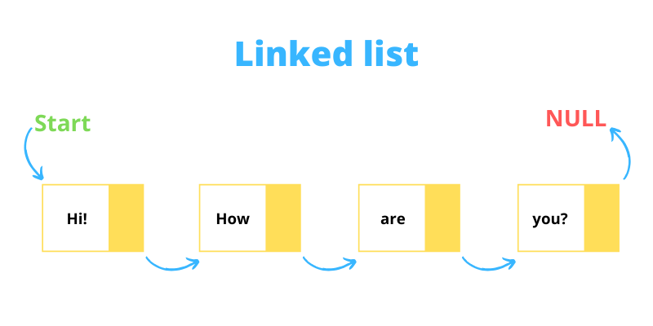
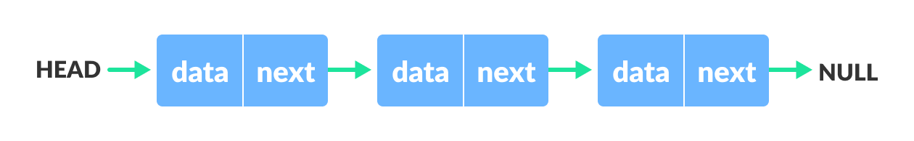
Linked list: Single linked

Slide 7
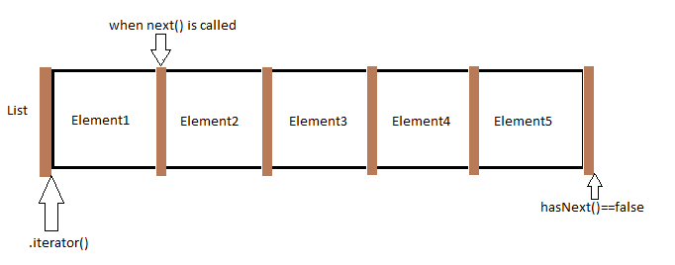
Iterator
Methods:
hasNext()
next()

Slide 8
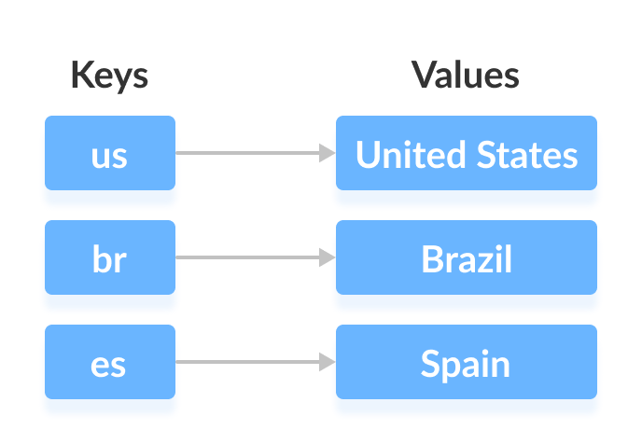
Map/Dictionary

